Slide 1
Rajdhani Hotel
PreseNTED By : Shubham Yadav & Akash hatagale
Under the guidance of : prof. Kirti Samrit

Slide 2
Index
Introduction
Existing System
Scop of the System
Oprating Anvironment
Propose of System
Objective the System
Design
User Interfase
Future Enhancement
Limitation
Conclusion

Slide 3
Introduction
In my project “Rajdhani Hotel ” I have tried to show how the data/information in hotels is managed. This is just an overview of management in hotels. It manages and maintains the records of customers, rooms, employees and drivers in the hotel. The project is aimed to maintain the day-to-day state of admission/vacation of Residents, List of employees, room details etc. Main objective of this project is to provide a solution for hotels to manage most their work using computerized processes.
This software application will help admin to handle customer information, room allocation details, Payment details etc.
The rooms have different categories like single bed, double bed etc. so their charges and records will be maintained accordingly.

Slide 4
Existing System
In the existing manual system a lot of time is spent in communicating the information across different branches. There is a need for an automated system, which has some centralized control over the entire process.
Conventional System makes use of huge amounts of paper for recording transactions. All the Hotel records are to be maintained for the details of each customer, Fee details, Room Allocation etc.

Slide 5
Scop of the System
Today hotel management is not only confined to hotels but has gone deep into tourism, catering, clubs, etc. making it a very paying and an exciting career option.
With the rapid growth of the hotel industry pushed forward by foreign and domestic tourism and business travels, the demand for well trained and quality personnel too has gone up high. India is one of the preferred tourist and travel destinations.
In future more features may be added category-wise. It may try to analyze the user behavior and preferences and accordingly suggest.

Slide 6
Oprating Anvironment
Hardware Requirements :-
Processor : Intel
RAM : 2 GB
Hard Disk : 64 GB
Printer : Laser Printer
Software Requirements :-
Operating System : Windows10
Front End : Java core,swing(AWT Components)
Back End : MySQL

Slide 7
Propose of System
Proposed system is the computerized version of the existing system which provides easy and quick access over the data.
Keeping the records of admission of Resident properly so that facilities provided by hotels are fully utilized in effective and efficient manner.
In proposed system customer and organization data will be secure with facility of username password also these system gives facility to assigns the roles and rights.
System will be error free, secure, reliable and fast management system
Advantages:
Less Time consuming
Maintain accuracy

Slide 8
Objective the System
The objective of the Rajdhani Hotel is to develop a project which maintains booking of rooms, providing drivers, etc. It is a windows based application to be implemented in Java
The Purpose of the whole process is to ease the daily or regular activities of the Hotel Management into an automatic computerized retrievable process. The daily activities includes the Room activities, Entering details of the new customer check in, To allocate a room as per the customer need and interest, Recording the checkout time and details, Releasing or Empty of room and to record the process in a computer system for future.
Main objective of this project is to provide a solution for hotels to manage most their work using computerized processes. This software application will help admin to handle customer information, room allocation details, Payment details etc.
Keeping records of admission of customers.
Facilities provided by hotels are fully utilized in an effective and efficient manner.

Slide 9
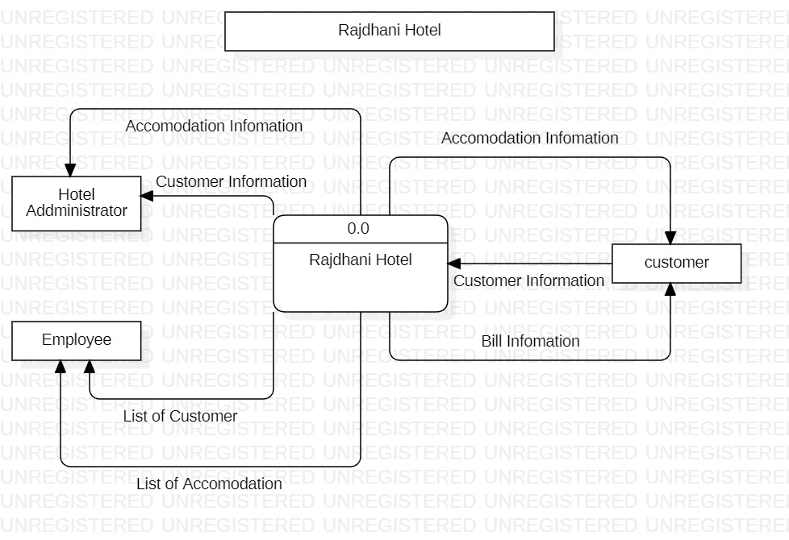
Design
Data Flow Diagram
0 Level DFD

Slide 10
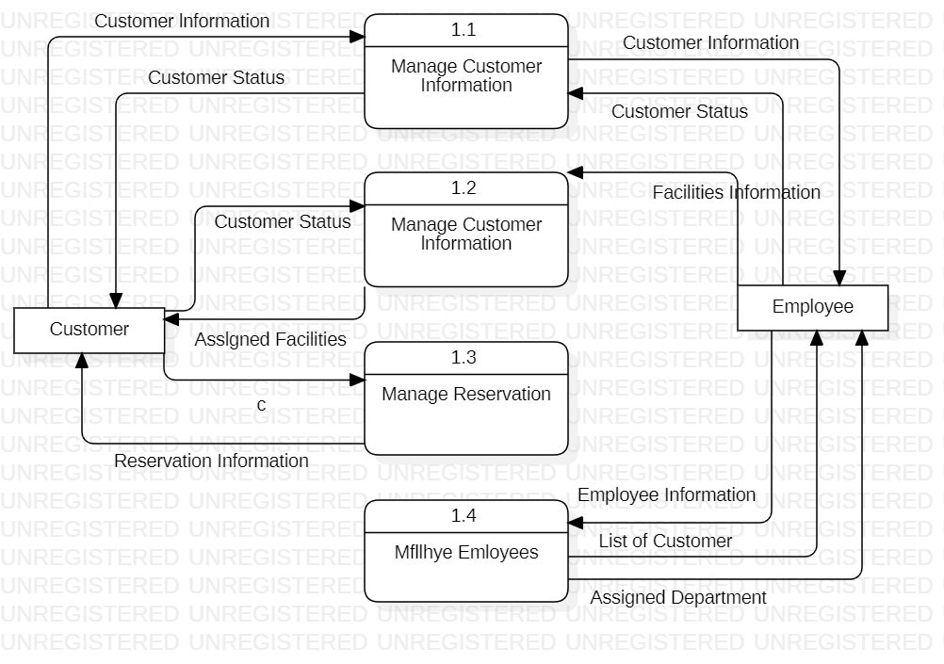
Level one DFD

Slide 11
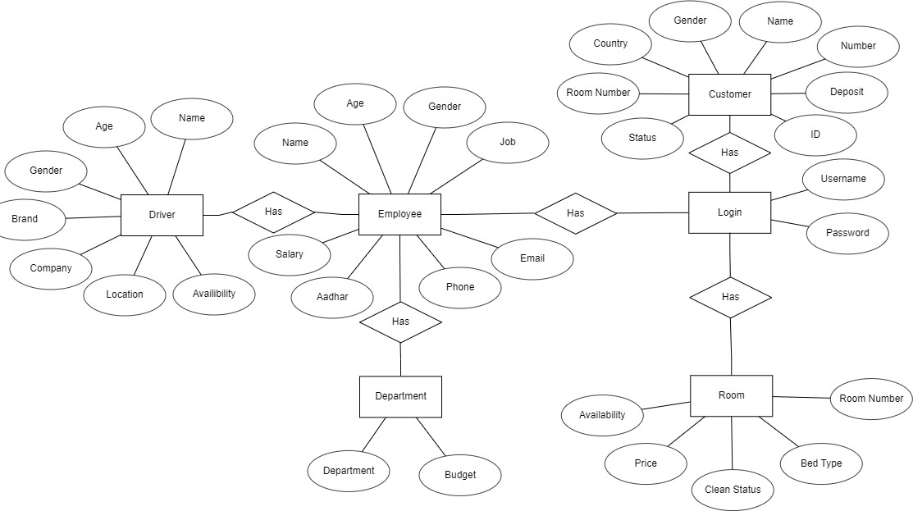
Entity relationship diagram

Slide 12
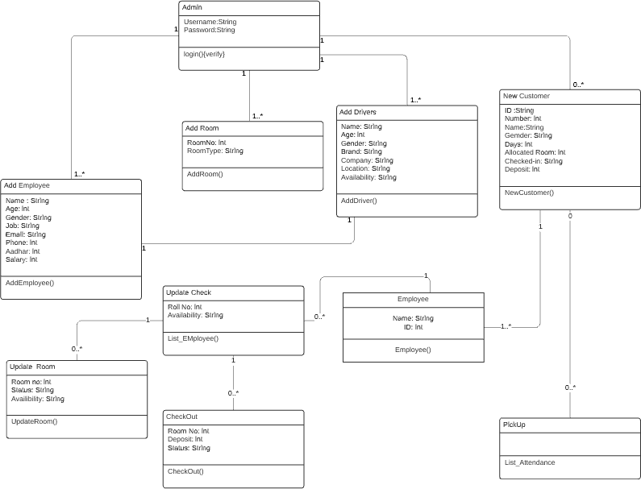
Class Diagram

Slide 13
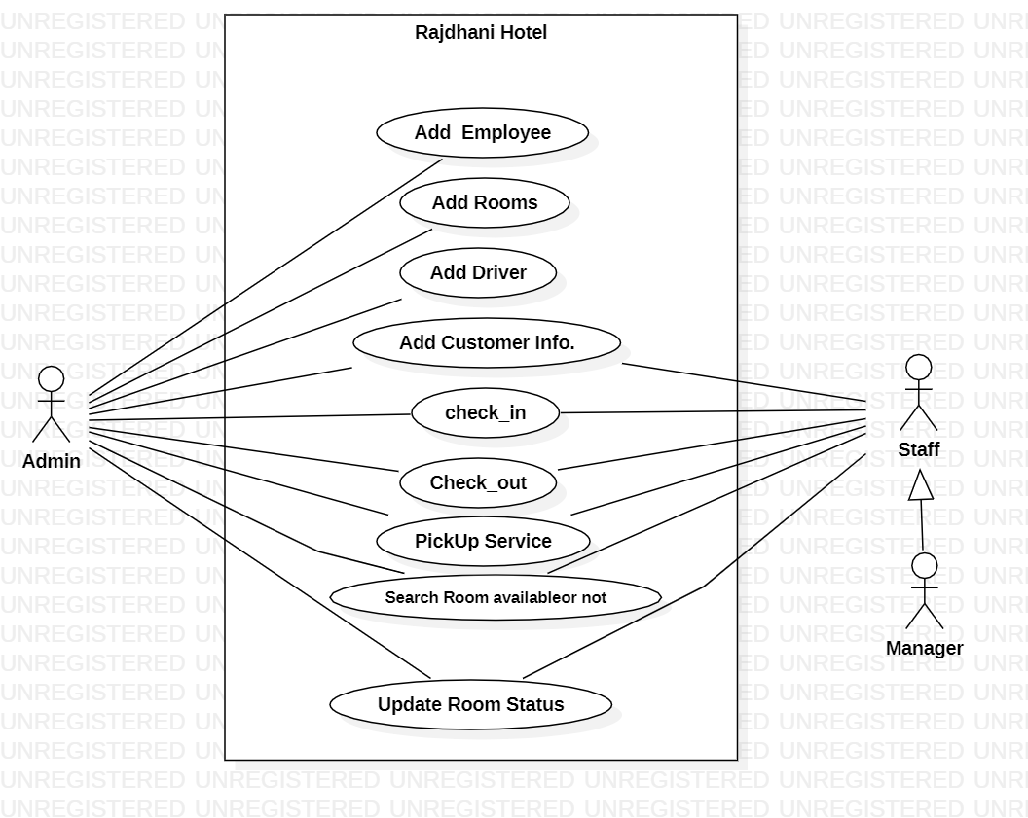
USE CASE DIAGRAM

Slide 14
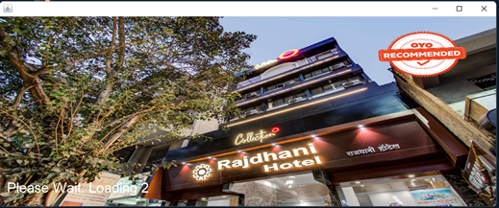
User Interface
1)Start Screen

Slide 15
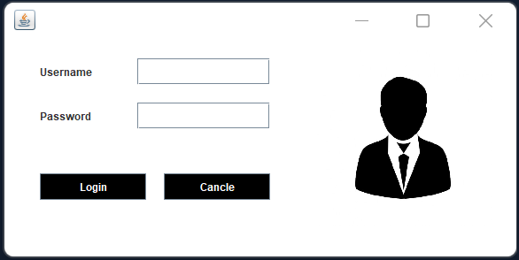
User Interface
2)login Screen

Slide 16
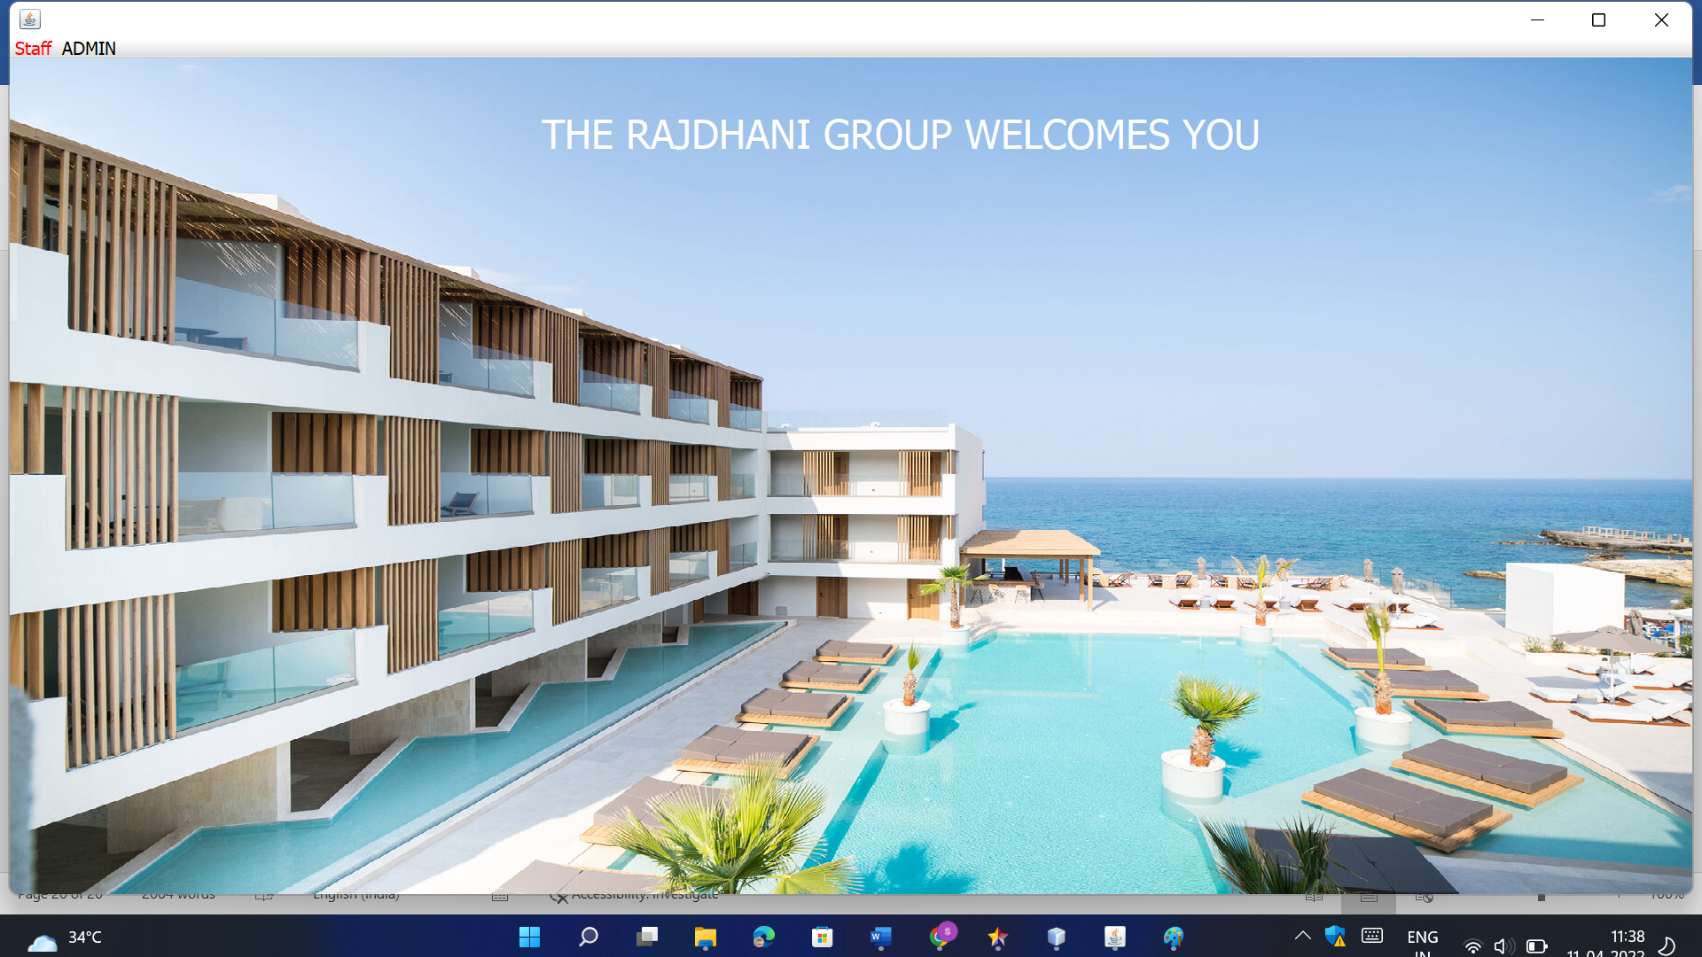
User Interface
3) DashBoard Page

Slide 17
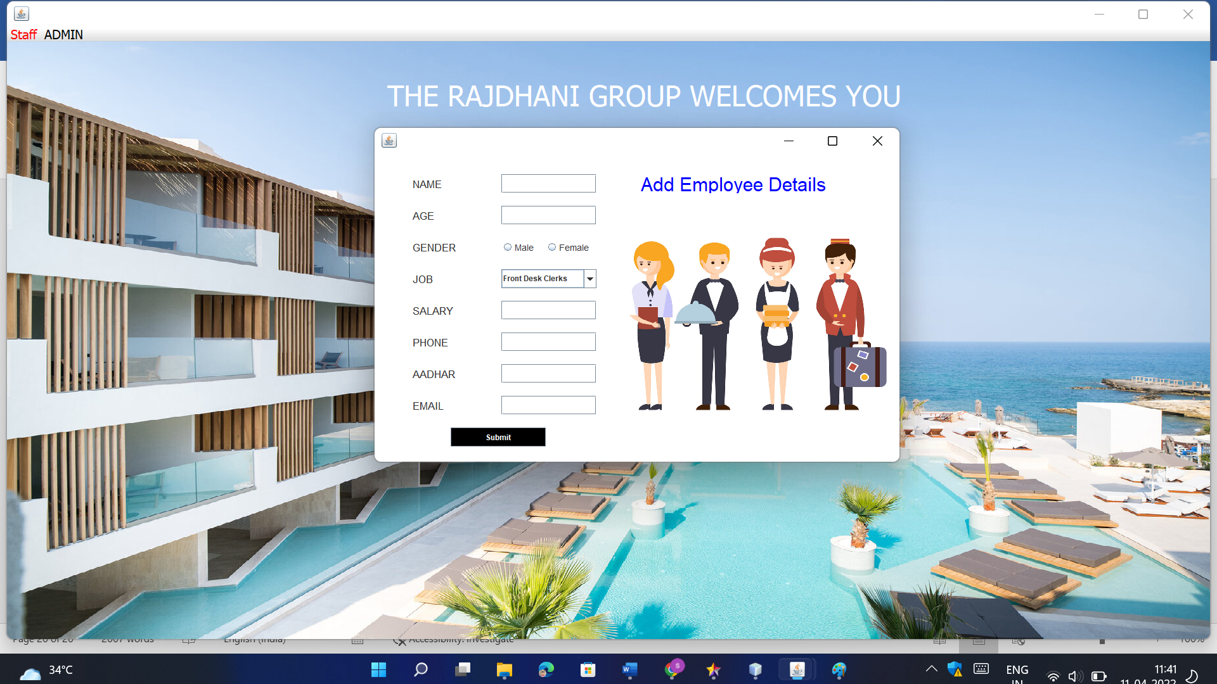
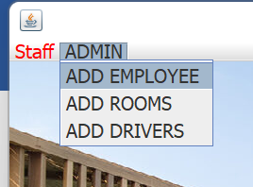
User Interface
4) Add Employee

Slide 18
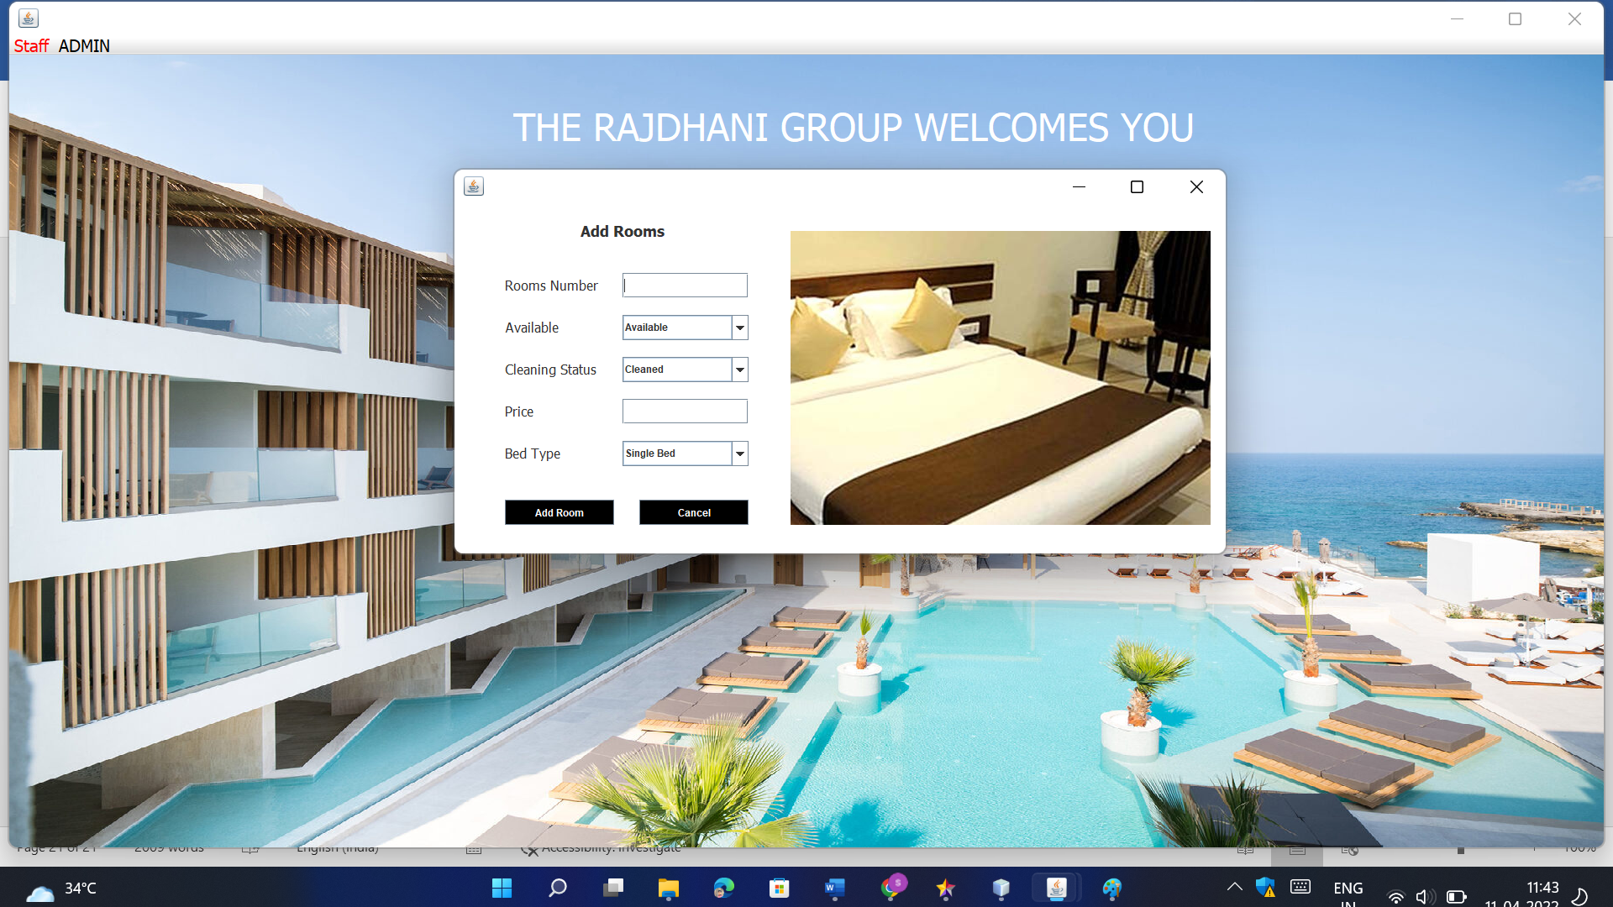
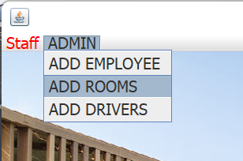
User Interface
5)Add Rooms

Slide 19
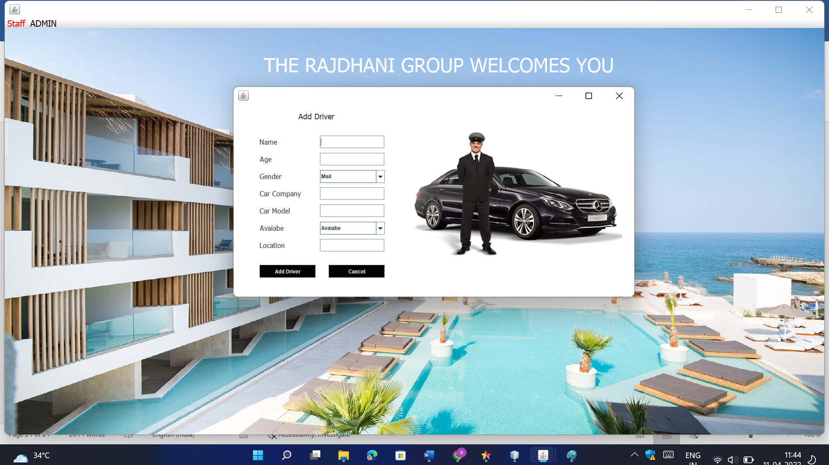
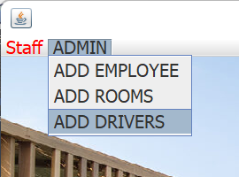
User Interface
6)Add Driver

Slide 20
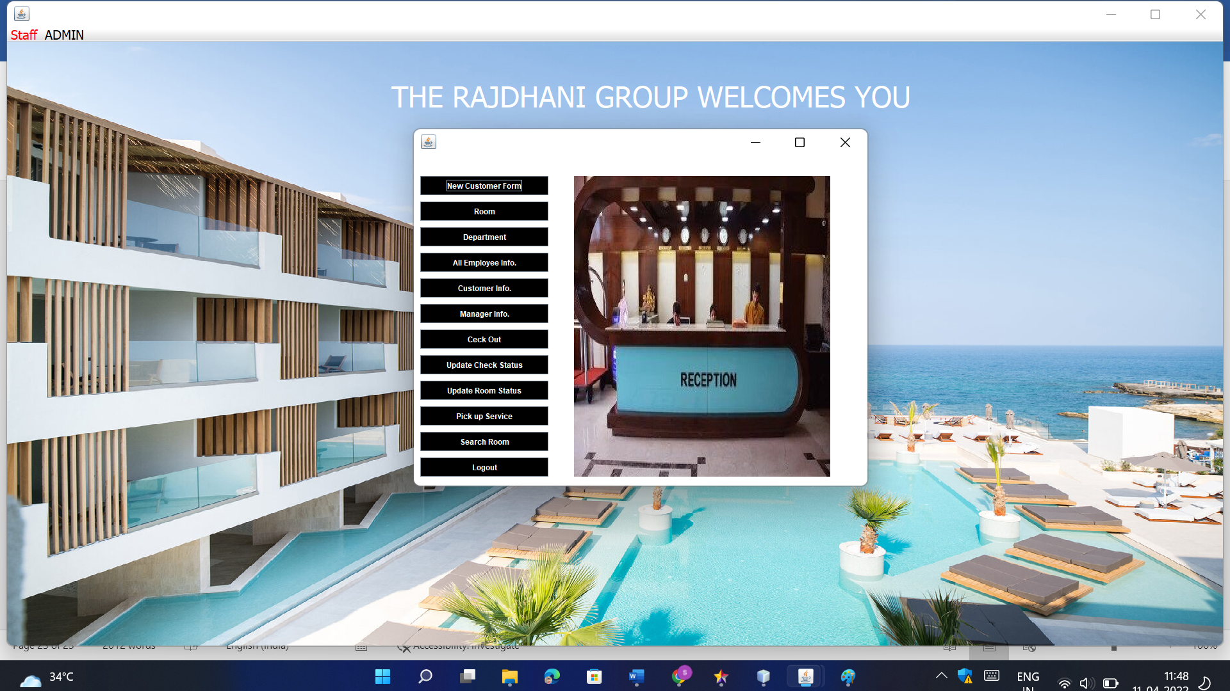
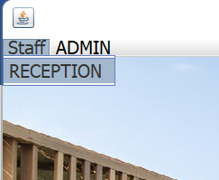
User Interface
7)Reception

Slide 21
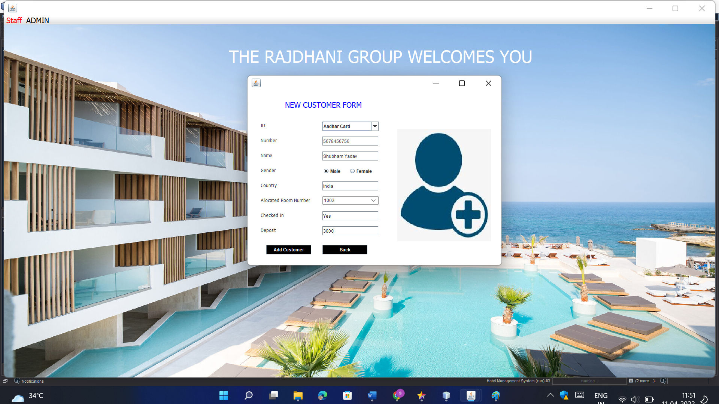
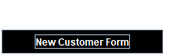
User Interface
8)Add New Customer

Slide 22
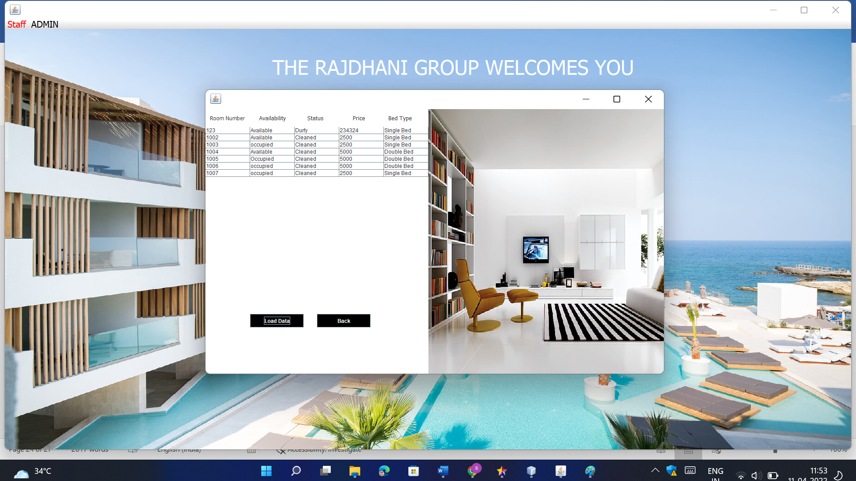

User Interface
9)Room Details

Slide 23
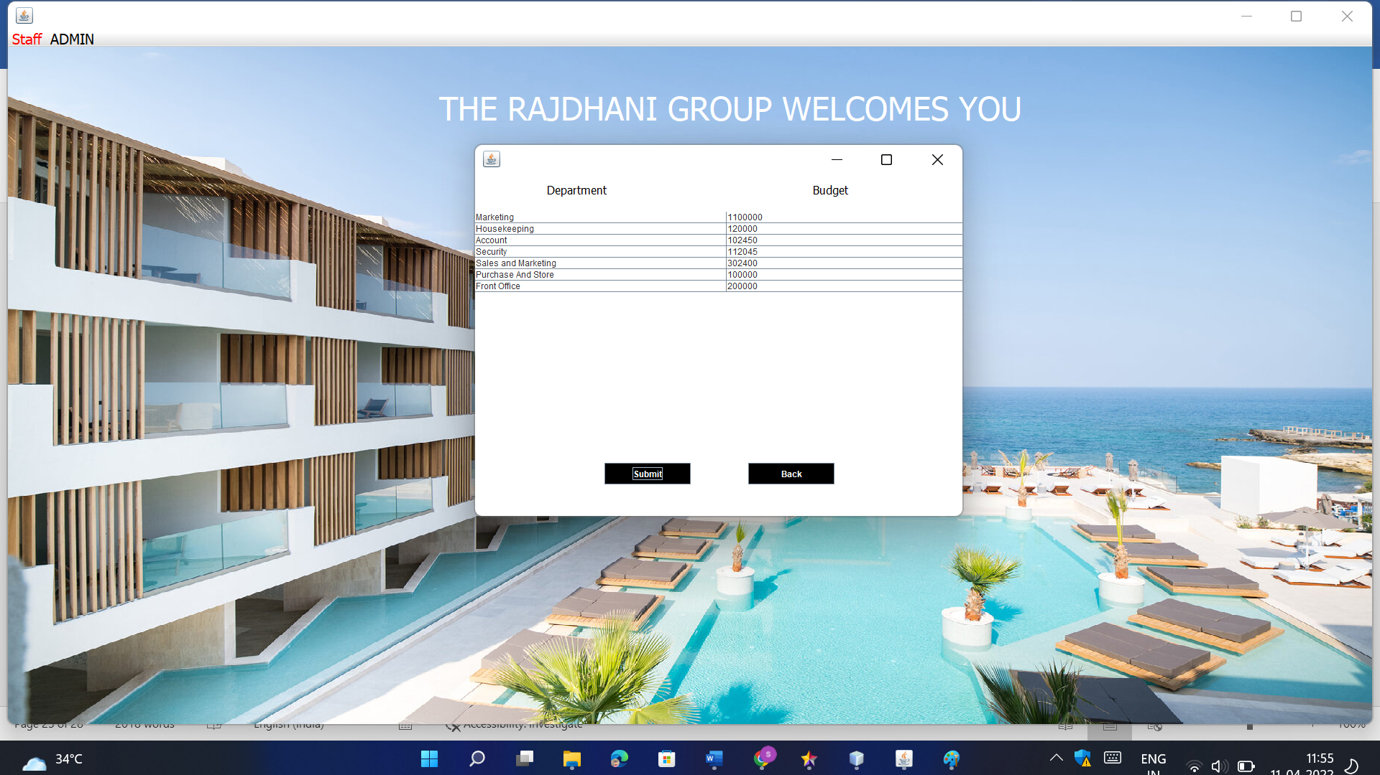

User Interface
10)Department

Slide 24
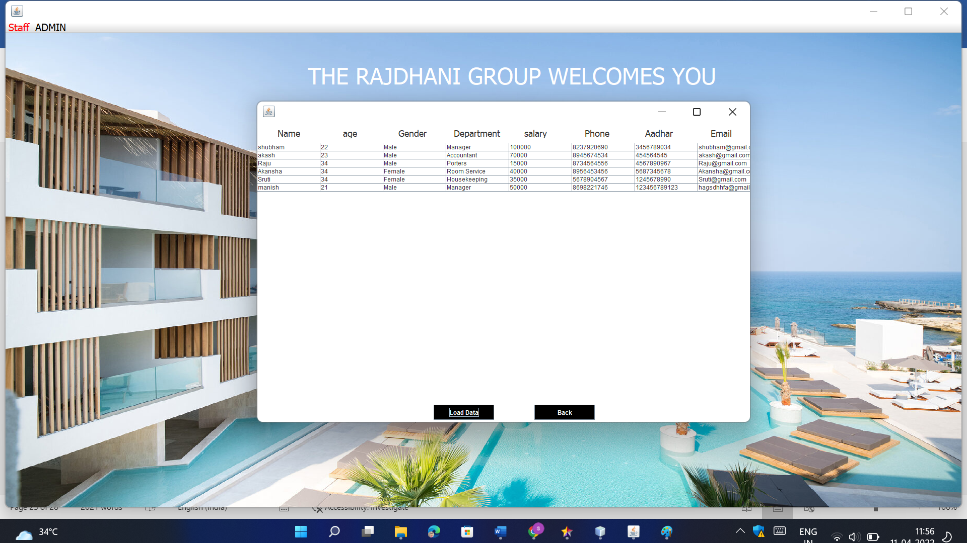

User Interface
11)All Employee Info.

Slide 25
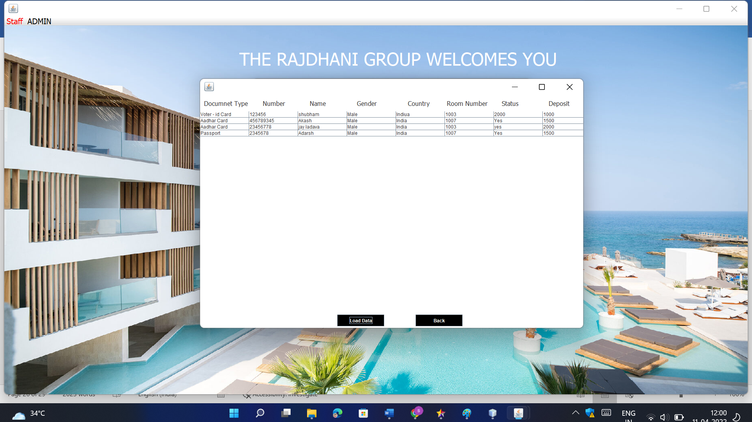

User Interface
12)Customer Info.

Slide 26


User Interface
13)Manager Info.

Slide 27
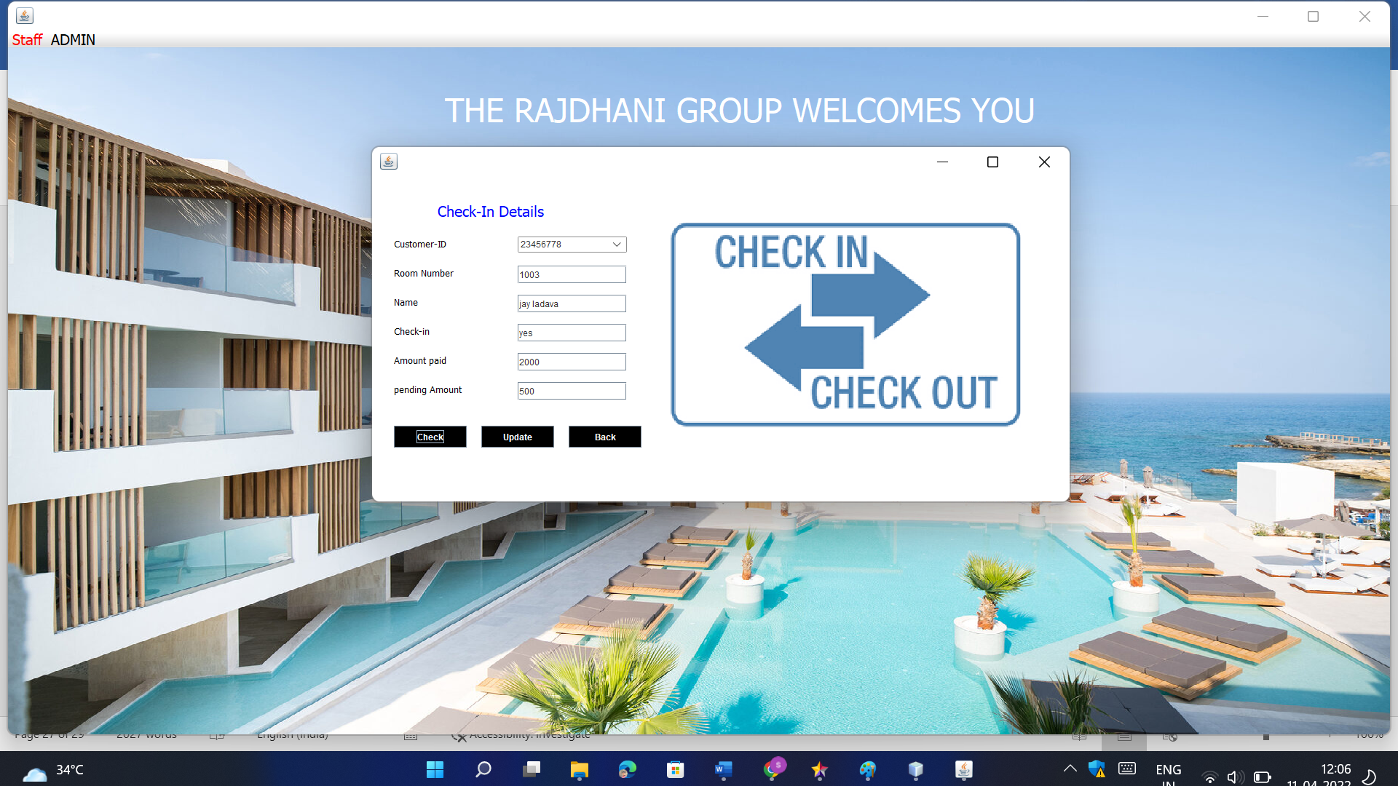

User Interface
14)Check-In Details

Slide 28
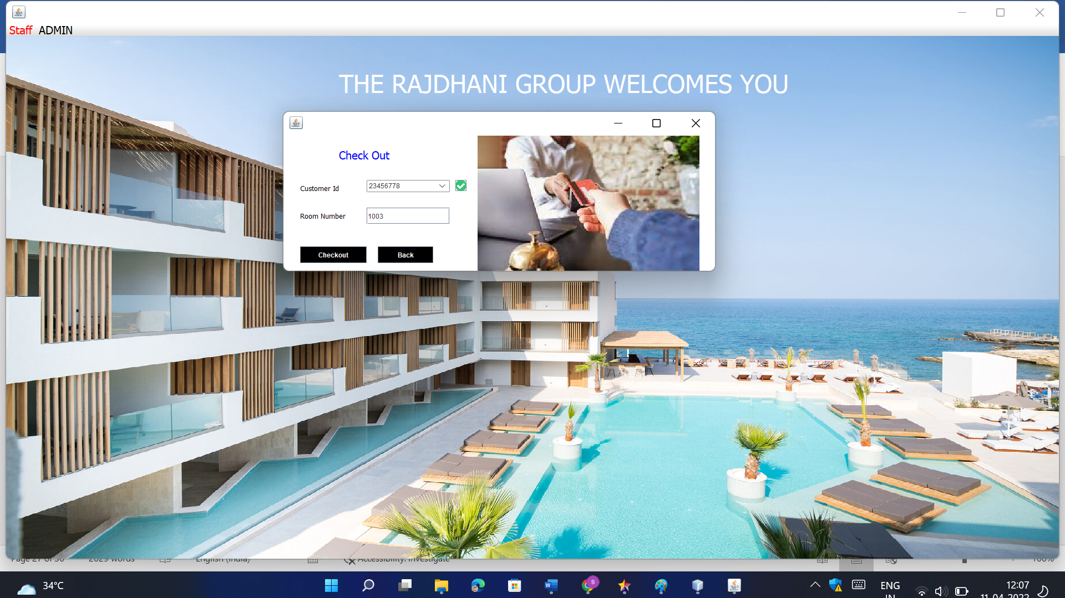

User Interface
15)Check-Out Details

Slide 29
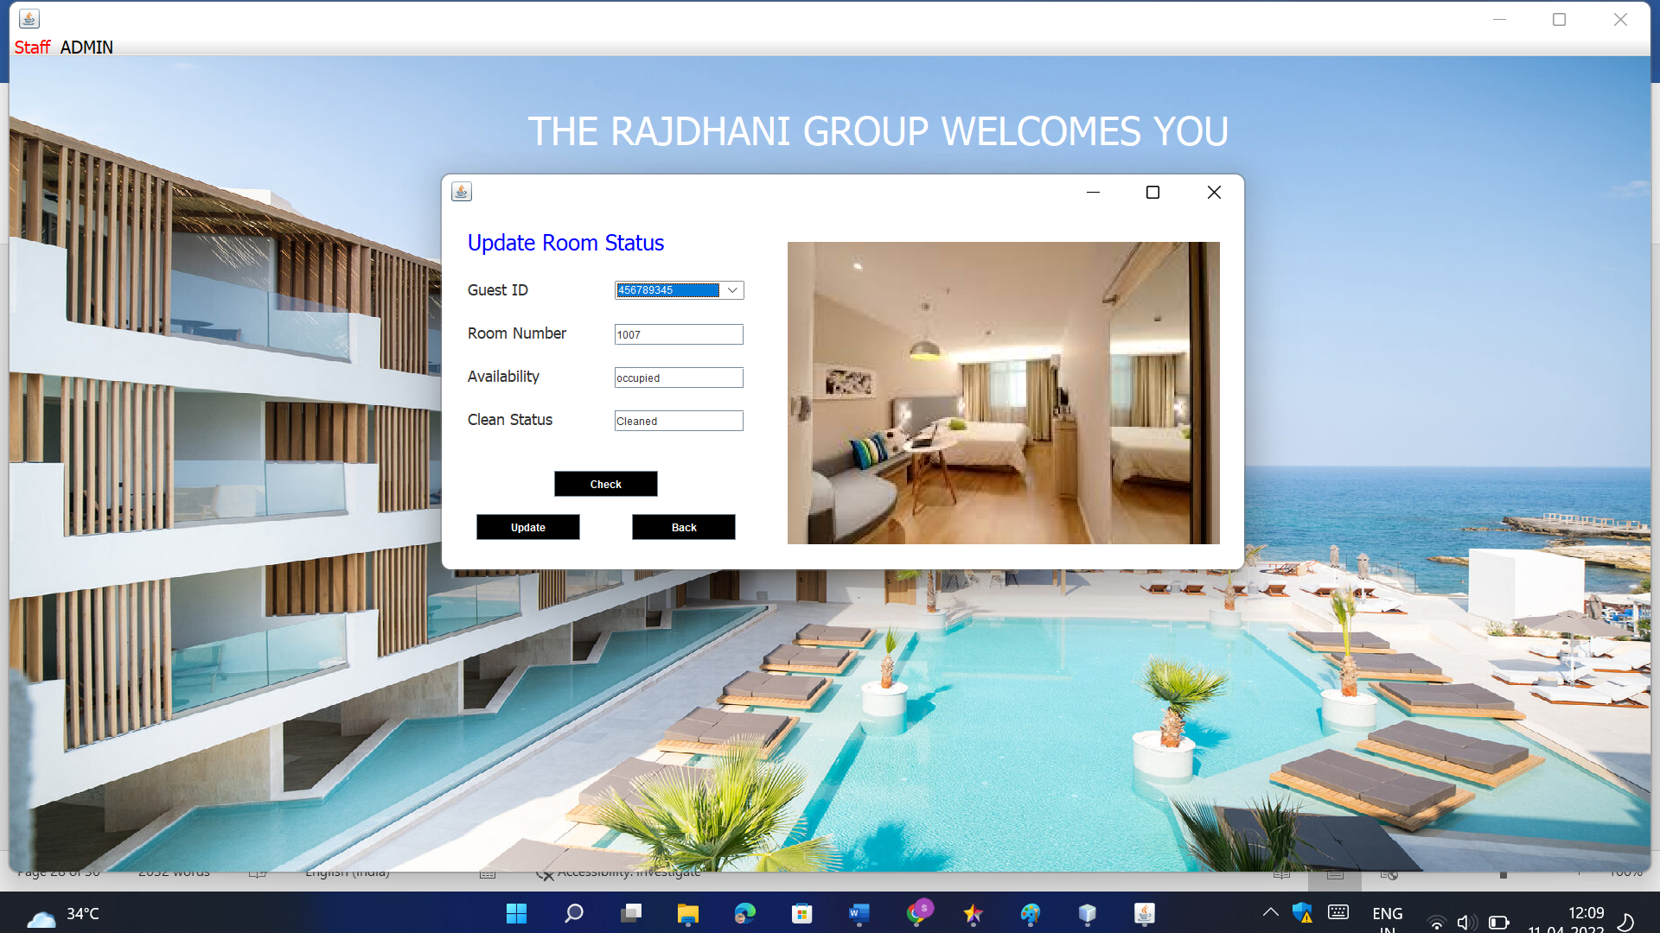

User Interface
16)Update Room Status

Slide 30
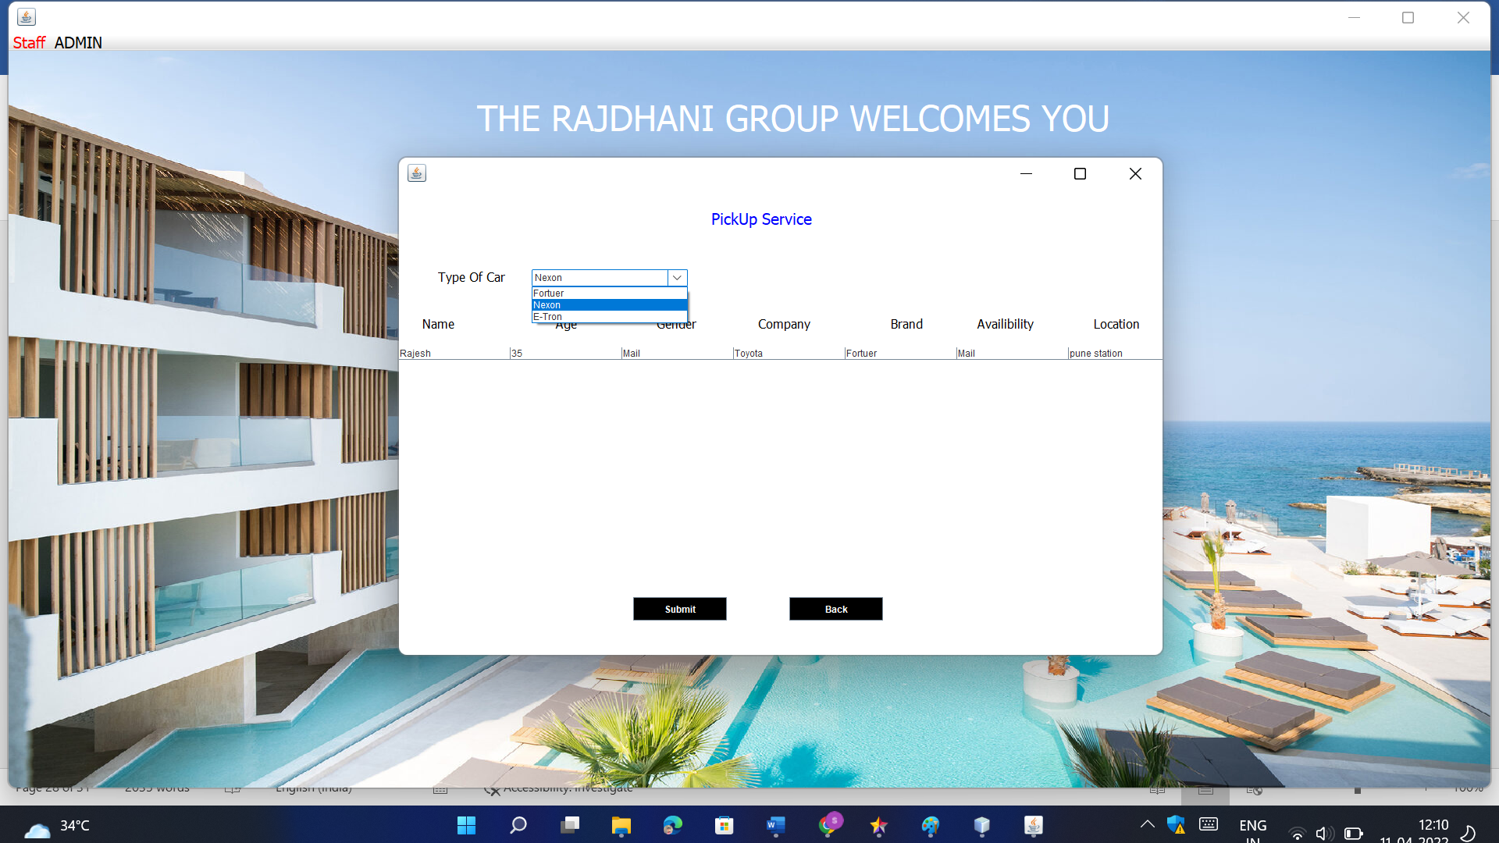

User Interface
17)Pick Up Service

Slide 31
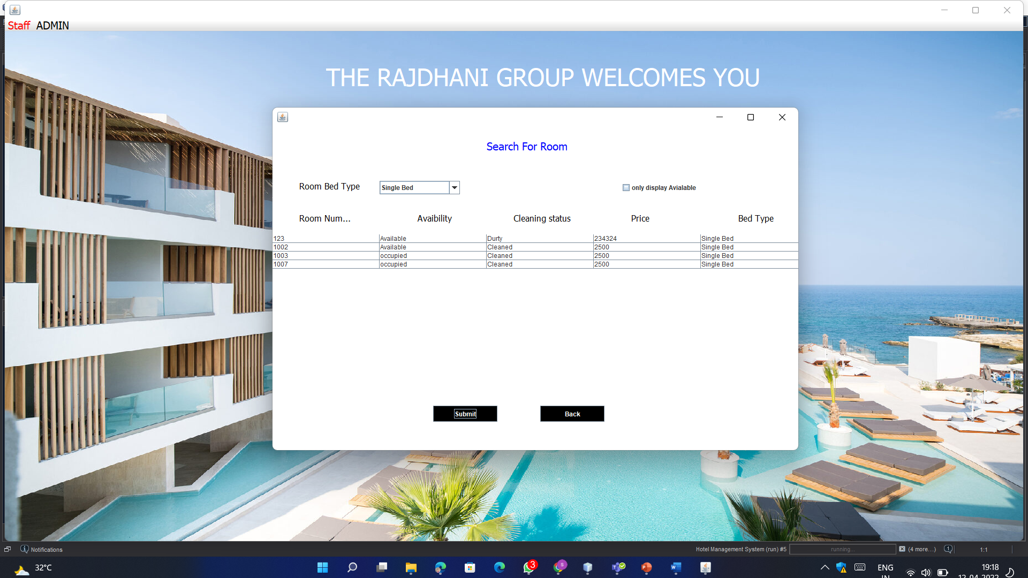

User Interface
18)Search Room

Slide 32
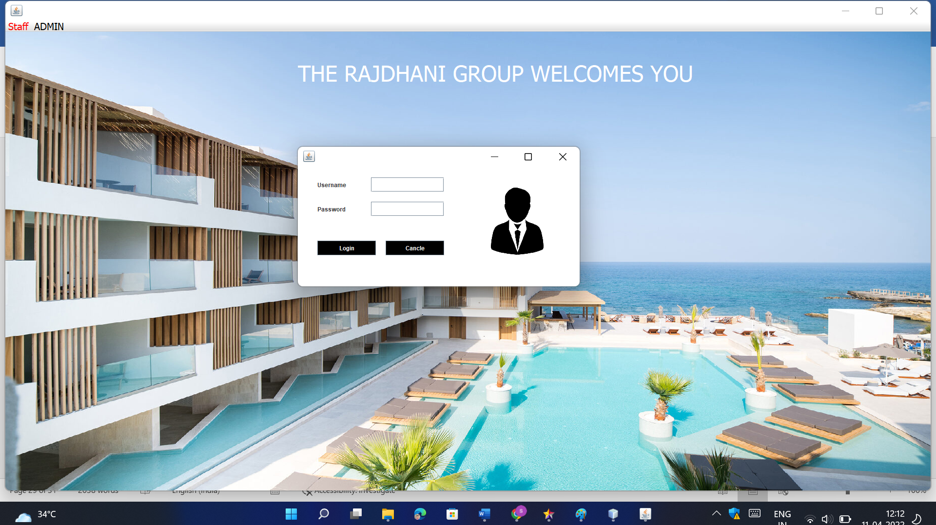

User Interface
19)Logout

Slide 33
Future Enhancement
The world is changing rapidly and so is the meaning of the Rajdhani System. Today hotel is not only confined to hotels but has gone deep into tourism, catering, clubs, etc making it a very paying and an exciting career option.
With the rapid growth of the hotel industry pushed forward by foreign and domestic tourism and business travels, the demand for well trained and quality personnel too has gone up high. India is one of the preferred tourist and travel destinations. Approx 4.4 million tourists visit our country every year. The growth of 20% has been recorded in the tourist and hospitality industry over a few years and more growth is expected in coming years. At present, there are about 200 millions of jobs available in the industry, out of which 20% of the job opportunities are in India.
The Rajdhani Hotel has a lot of enhancement options. In future more features may be added category-wise. It may try to analyze the user behaviour and preferences and accordingly suggest. All concepts can be applied to make the Rajdhani Hotel more efficient.

Slide 34
Limitations
The booking process usually requires a customer identity, which the system cannot detect.
It requires a reliable internet connection

Slide 35
Conclusion
In this project I have tried my best to make user friendly software. This software can be handled by any person who has little bit of idea of computers. In this software I have tried to meet most of the requirements of the present hotel management system including maintaining details of customers, rooms, employees and drivers. I also keep provision to update the details of customers, rooms and employees. In my effort I have tried to make my software all the more user friendly but there may some features which I would like to include in my continuous attempts.

